Slide 1

课时练习
模块七 第三章 第二节

Slide 2
一、翻译下列词组。
1. 电话订餐 ____________________________
2. 柠檬茶 __________________________
3. 30分钟后 ____________________
4. 特色菜 __________________________
order a meal by phone
lemon tea
in thirty minutes
special dishes

Slide 3
一、翻译下列词组。
5. 主食， 主菜 _____________________________
6. 就坐； 入座 _________________________
main course
have/take a seat/sit down

Slide 4
二、根据语境、音标或所给单词的提示完成句子， 每空一词。
1. Best buys this week are ________(carrot) and cabbages. They are both on sale.
2. Rich in vitamin(维生素) C, _______ /lemon/ juice is good for our health.
3. French ______ /waɪn/ is famous all over the world.
carrots
lemon
wine

Slide 5
二、根据语境、音标或所给单词的提示完成句子， 每空一词。
4. Please __________ a seat, everybody. The meeting will begin soon.
5. Eating too many __________ (bean) will give you wind(肚子胀气).
have/take
beans

Slide 6
三、单项选择。
( )1. —How much rice do you want?
—Just _______.
A. little B. a few C. a little
C

Slide 7
三、单项选择。
( )2. If you don’t let me _____ a taxi, then at least allow(允许) me to lend you something..
A. look for B. pay for C. care for
B

Slide 8
三、单项选择。
( )3. —________will you send the food here?
—In 20 minutes.
A. How soon B. How long C. How often
A

Slide 9
三、单项选择。
( )4. Many people in China like to ______ food online and wait for it to be delivered(配送) to their home.
A. send B. order C. cook
B

Slide 10
三、单项选择。
( )5. —_________________?
—Let me see. It’s 20 dollars.
A. How much is the bill
B. May I have the bill
C. How much does the bill cost
A

Slide 11
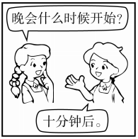
四、看图写话。
1. begin, in
The evening party will begin in ten minutes.

Slide 12
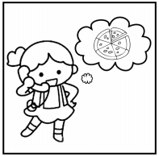
四、看图写话。
2. be, order, by
The girl/She is ordering a pizza by phone.

Slide 13
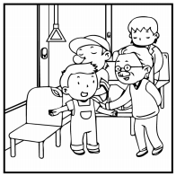
四、看图写话。
3. give … to
The boy/He gives/gave his seat to the old man.

Slide 14
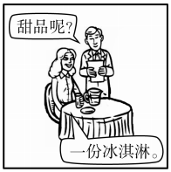
四、看图写话。
4. like, have … for
The woman/She would like to have an ice cream for dessert.

Slide 15
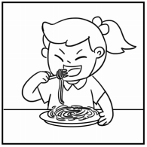
四、看图写话。
5. often, eat, fork
The girl/She often eats noodles with a fork.

Slide 16


